Slide 1
Exchange Rate KZT – USD
Mussa Aman
Data Science

Slide 2
WHY THIS IS IMPORTANT
The prices of imported goods are affected by exchange rates.
The fluctuation of commodity prices affects people's lives all the time.
Food, clothing, housing, transportation and …
It changed from 140 to 476 / 02.01.2000-09.01.2022

Slide 3
Prediction
Precausion
Understand
Solution
WHY THIS IS IMPORTANT
It is important for investment.
It is critical for making financial decisions.
It is essential for us to know how Macroeconomic works.
Know how to deal with the rise and fall of the exchange rate

Slide 4
Research Hypothesis
BALANCE OF TRADE
INFLATION
01
02
EXPORTS & IMPORTS
INFLATION RATE
When a trade deficit occurs, the exchange rate falls.
When the inflation rate is high, the exchange rate falls.

Slide 5
BALANCE OF TRADE
Research Hypothesis
INFLATION
Kazakhstan's economic exports are dependent on crude petroleum and petroleum gas.
Once the price of crude and gas decreases, a trade deficit will occur.
Fluctuations in prices, changes in exchange rates will seriously affect inflation.
Once two things happen at the same time, a vicious circle is formed.
When a trade surplus occurs, the exchange rate increases.
When the inflation rate keeps low, the exchange rate increases.

Slide 6
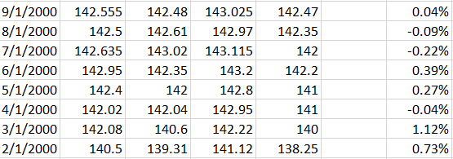
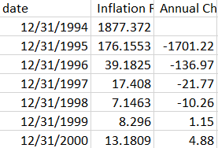
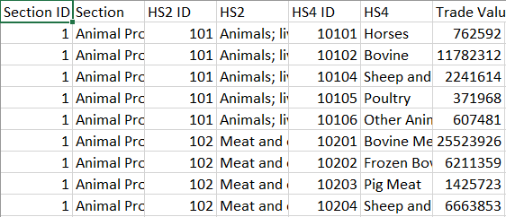
Datasets
Here, 3 datasets are collected:
The change of exchange rate USD – KZT monthly from 2000 to 2022 year.
The export & import from 2000 to 2022.
Inflation rate from 2000 to 2022

Slide 7
Thanks for Attention

